Slide 1
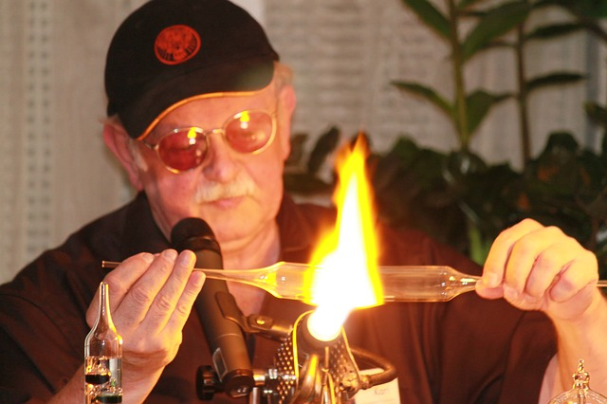
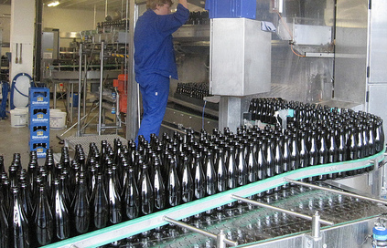
Preservation Strategies Review
Richard Wright
Preservation Guide, UK
@RichardWright

Slide 2
Summary
Background
Me and the UK Oral History Society
The Problem – what’s out there?
Strategies – transfers, digitisation, making files, coping with the crunch
Prospects – some statistics on what’s entering and leaving audiovisual archives
Next 100 Years – the future of storage
Conclusions – about likely successes and failures

Slide 3
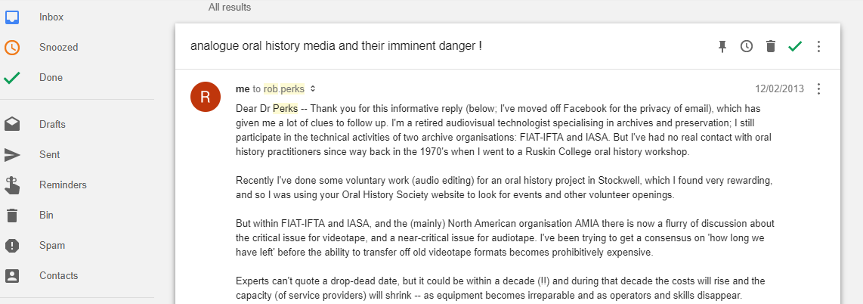
“People with decades of experience in the field are saying 'This is it, Birdseye' (or something similar) about video: there is just no time to wait any longer. Analogue videotape needs to be under a preservation plan, now, or it has little hope of survival.”
“So that's the message: do it now, as there is no expectation of affordable or even unaffordable digitisation beyond the next decade.”

Slide 4
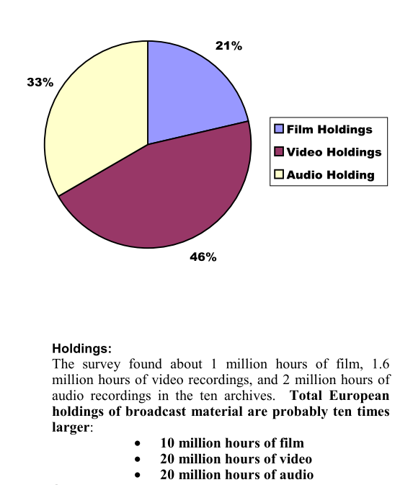

What’s Out There?
Flickr: Cochinogarcia CC
Notes:
https://www.flickr.com/photos/cohinogarcia/6160102631/in/photolist-aom8U4-Wf1xxq-ceZbWC-d5eggy-EYkasN-bpcUw6-9xiuoC-g1KZ7p-bW8nKq-6Nz5Wd-9XT3BP-7wjBcN-a4wcWg-XhVA4e-9mMqHx-by2oWT-4ytmi-dsBTuW-92sCYu-aF1JSc-9xinGG-4iHrxW-QPNrxr-7qhhVb-boHRtp-bEm86H-a4sk8e-kbee7P-bEKdHx-b8iM4Z-d7yZvU-eSxy3p-a4vjow-a4q9ft-m8Yc4T-9xfGxV-m1NeDq-7rzvtN-a4vhem-g1Ljrp-a4w4hz-Xvzin1-4pJPVM-4dDRZx-7tbFVq-bAWJfZ-68Nteo-draRVz-4R4qAj-ebZXf7

Slide 5
Surveys:
1981: BUFVC - The Researcher’s Guide; 2006: 640 audio-visual collections from the United Kingdom and Ireland
2002 Presto - 1 million hrs of film, 1.6 million hrs of video recordings, 2 million hrs of audio recordings. “2/3 obsolete, 1/3 damaged, ¼ fragile”
"Extrapolation" (multiply by 10) => 50 million hours across Europe. Doubled for world, doubled again by UNESCO for their website "200 million hours". World Day for Audiovisual Heritage (27 Oct).
2004 PrestoPrime - 20 European countries, 10 million hours
2007 CAVPP California Preservation Survey of Moving Image and Recorded Sound Collections
32 libraries, 1 million moving image and sound recordings.
"A survey instrument specific to audiovisual materials, CALIPR" [worst practice]
Notes:
http://bufvc.ac.uk/publications/books/the-researches-guide
http://presto.joanneum.at/projects.asp#d2
http://www.prestoprime.org/docs/training/Preservation_broadcast_archives_RW.pdf
https://calpreservation.org/information_resources/preservation-management/av-surve/

Slide 6
More surveys:
2008 TAPE = 374 AV collections across Europe: 25 million hours (5 million hour overlap with PrestoPrime) => 30 million hours documented.
70% in "acceptable" condition, but 50% no controlled storage, 50% no regular equipment maintenance, 70% no preservation plan.
2009 Indiana University 560k items on one campus
2015 British Library Save our Sounds - 1.8 million recordings, 3000 collections, 488 "collection holders" in UK.
The majority not digitising their holdings, hoping for rescue from “Save our Sounds” project, which aims to digitise 500k of these recordings.
2018 BFI Heritage 2022 Video Tape Collections Audit
Notes:
http://www.tape-online.net/docs/tracking_the_reel_world.pdf
https://www.ica.org/en/tracking-reel-world-survey-audiovisual-collections-europe
https://mdpi.iu.edu/about/index.php

Slide 7
Conclusions on Surveys
The real questions is no longer "what's out there" because the answer is generally well known: lots and lots.
Urgent questions:
what is its condition?
what is its value?
is it included in a preservation strategy?
All at risk AV content should be within a formal preservation strategy (which need not be an expensive or laborious process).
But costed preservation plans do require detailed knowledge of the status (and purpose and value) of a collection.

Slide 8
Preservation strategies – and Ethics
Ethics – Do your best? Do something rather than nothing? At least try? Do what you can afford? “We all have to be pragmatic.” “The perfect is the enemy of the good.”
« Le mieux est l'ennemi du bien » Voltaire –
who also said « La vertu s'avilit à se justifier. »
Audiovisual archiving: philosophy and principles – Ray Edmundson
“As far as possible, the new preservation copy should be an exact replica of the original” 6.4.9 p67
“If the best equipment is not available, and a lower grade digital copy from an endangered carrier is possible, it is better than doing nothing” 2.8.4 p17
Notes:
http://www.unesco.org/new/en/communication-and-information/resources/publications-and-communication-materials/publications/full-list/audiovisual-archiving-3rd-edition/

Slide 9
Preservation strategies – and Technology
1970 – what to do with nitrate film? “Nitrate won’t wait”
1990 – what to do with analogue videotape?
1995 – what to do with sepmags (acetate magnetic sound tracks)?
2000 – transferring (digitising, ripping) to create files
what to do about originals?
what is the artefact?
What is the goal?
And now – digital preservation

Slide 10

Preservation strategies – and Economics
2008 – Coping with the Crunch
Flickr: Renegade98 CC
Notes:
https://www.flickr.com/photos/joshuatree/4180438436/in/photolist-5ntfRq-5ntfPy-5ntcK3-5noW6z-5ntcPW-qUj1Y5-5s1car-7npQGL-5ok1dD-sei1PB-rhxh9t

Slide 11
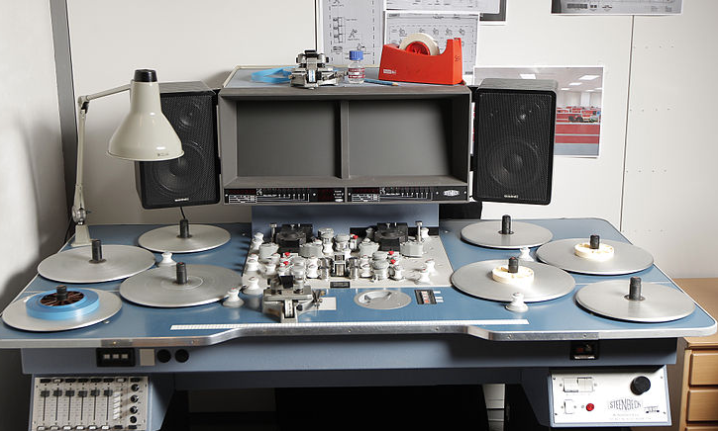
Flatbed film digitisation
HD Camera added to existing viewing table (Steenbeck).
1920 x 1200, 8 bit
24 fps; can transcode to PAL or NTSC HD video
Cost: £60/hr instead of £500
Sited ‘in-house’; quick turn-around; can be operated by archive’s own staff
Not 2k; not 14 (or 12 or 10) bits
But: “production use it”
3000 items/6 months vs 220/yr
Wikimedia: DRs Kulturarvsprojekt from Copenhagen, Danmark
Notes:
https://commons.wikimedia.org/wiki/File:Steenbeck_16mm_flatbed_ST_921_(6498616815).jpg

Slide 12
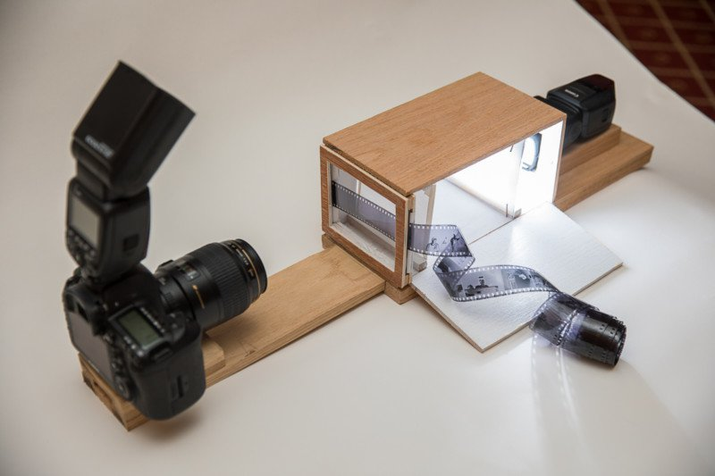
But where does it end?
Youtube: Digitising the BBC Film Archive with Fastforward
Notes:
https://www.youtube.com/watch?v=_h02naoc0CE
https://petapixel.com/2017/07/15/built-film-digitizing-lightbox/

Slide 13
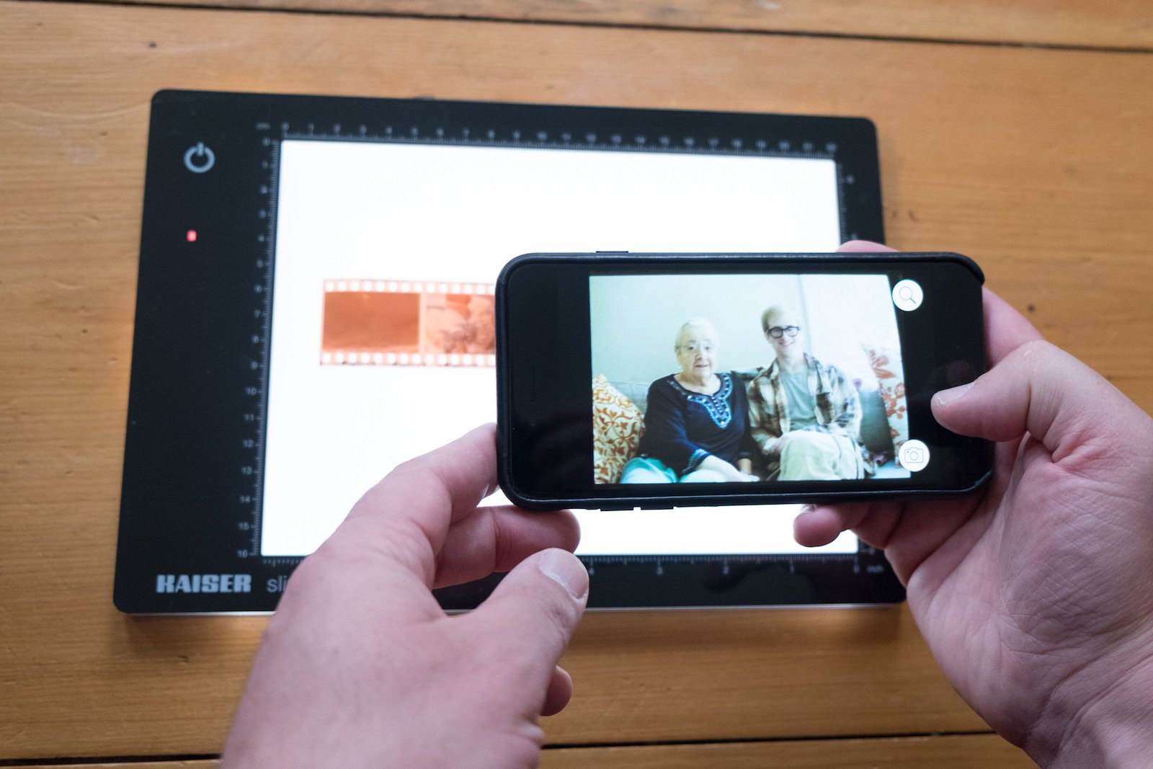
Notes:
https://petapixel.com/2017/05/11/ingenious-filmlab-app-easiest-way-turn-negatives-digital-files/

Slide 14
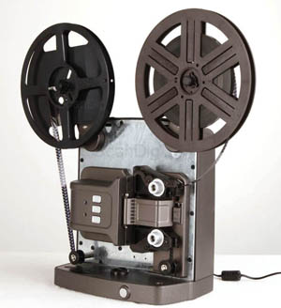
Super 8
Reflecta budget film scanner £400
Notes:
https://www.filmscanner.info/en/ReflectaSuper8Scanner.html

Slide 15
'real world digitisation':
AMIA 2016: "...these organizations cannot afford to wait for the perfect circumstances to achieve "archive quality" A/V digitization...“
Responses:
Univ Wisc: RADD
Iowa State: "Building a Video Preservation Rack for In-House Digitization AV CLUB"
XFR Collective: pop-up video transfer stations
DC Public Library Memory Lab - for use by the public
Notes:
https://radd.dsalo.info/
https://isuspecialcollections.wordpress.com/2017/07/27/building-a-video-preservation-rack-for-in-house-digitization-av-club-issue-1/
https://xfrcollective.wordpress.com/
https://archive.org/details/xfrcollective "providing low-cost digitization services“
https://www.dclibrary.org/labs/memorylab

Slide 16
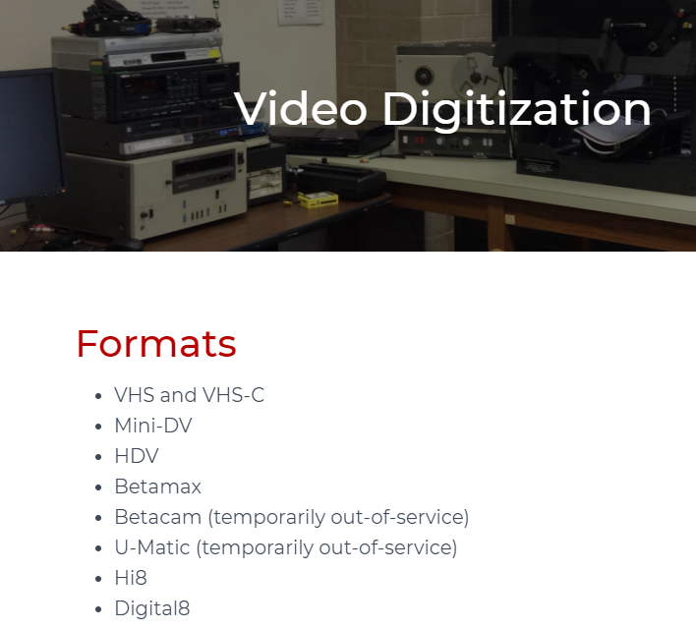
RADD: Recover Analog and Digital Data
University of Wisconsin
$22 per tape; $15 for state institutions
No mention of Timebase Corrector or of time code
2018: U-Matic and Betacam "out of service“
https://radd.dsalo.info/
Notes:
https://radd.dsalo.info/

Slide 17
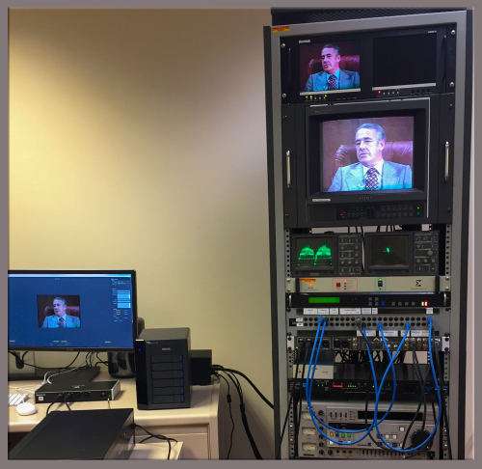
Iowa State: "Building a Video Preservation Rack”
Iowa State: "Building a Video Preservation Rack for In-House Digitization AV CLUB"
Explains a full, professional rack
Exemplary
Notes:
https://isuspecialcollections.wordpress.com/2017/07/27/building-a-video-preservation-rack-for-in-house-digitization-av-club-issue-1/

Slide 18
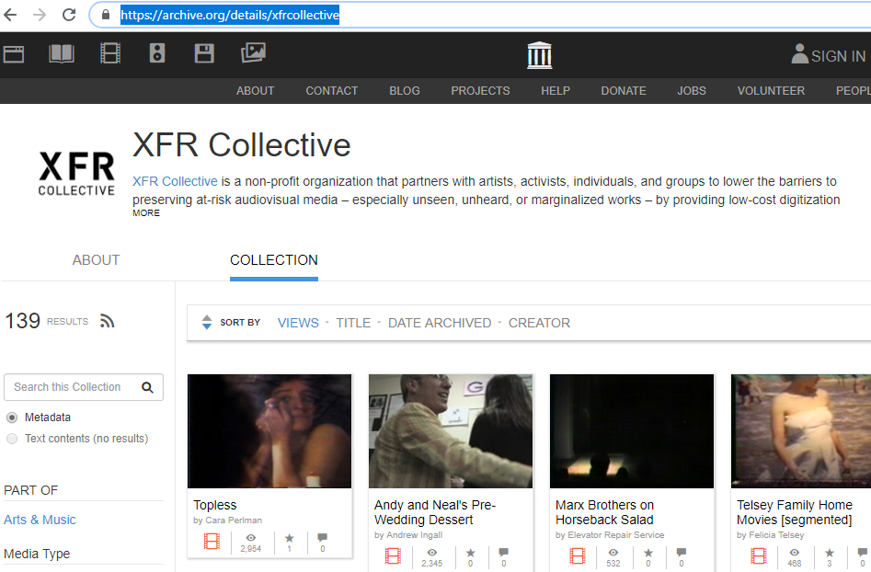
XFR Collective
pop-up video transfer stations;
for 'indies‘
"providing low-cost digitization services"
Notes:
https://xfrcollective.wordpress.com/
https://archive.org/details/xfrcollective

Slide 19

DC Public Library Memory Lab
for use by the public
•VHS
•VHS-C
•DV
•MiniDV
•Audiocassette
Notes:
https://www.dclibrary.org/labs/memorylab

Slide 20
"archive quality" A/V digitization
2015 Indiana University – and now other universities following their lead
Tate Galleries + MOMA (+ others)
Committed to highest quality, owing to the nature of their holdings

Slide 21
Issues (or slogans)
No Time to Wait
doing something is better than doing nothing
You Won't Get a Second Chance
- so do it right the first time
It comes back to STRATEGY
Where are you going? Preservation, Access, Both?

Slide 22
SEAPAAVA-16; Richard Wright; April 2012
Sample map: BBC 16mm film
Format | Age | Storage | Genre/value | Condition
16mm B&W film negatives | 1950 to 1970 | archive; uncirculated | Unique master material | good
16mm Ektachrome | 1968 to 1982 | office for first 5 yrs, then archive | News; high re-use | some colour fade
16mm B&W film prints | 1950 to 1970 | archive; | No permanent value: use negatives instead | fair: have been circulated
16m mag sound track | 1950 to 1980 | archive | Masters | vinegar syndrome!
16m mag sound track | 1950 to 1980 | archive | Duplicates; no permanent value | vinegar syndrome!

Slide 23
Preservation Strategy: BBC 16mm film
Type of material | Condition | Action needed | Timescale | In-house or contracted?
16m mag sound track - masters | vinegar syndrome! | digitisation to file formats; destruction of originals | 2 years starting immediately | Contracted; checking in-house
16m mag sound track - duplicates | vinegar syndrome! | destruction (after respective masters are transferred and checked) | 2 years starting immediately | In house
16mm Ektachrome | some colour fade | Access copies made on digibeta and DVD | Starting when budget allows: in 2 years | Preparation and checking in-house; telecine contracted out
16mm B&W film negatives | good | Maintain in appropriate storage conditions; review condition at intervals | Review plan and condition every five years | Review is done in-house
16mm B&W film prints | fair: have been circulated | Maintain in appropriate storage conditions | Keep until preservation actions taken on negatives | Storage is in-house

Slide 24
Preservation Plan: BBC 16mm film
Type of material | Preservation Action | Service Provider | Batching | Outcome | Quality Control
16m mag sound track – masters | Digitisation at CD quality: 44.1 kHz sampling @ 16 bits; synch pulses recorded on 2nd CD channel | Three outside contractors selected by competitive tender | Monthly basis | One audio CD and one BWF file (on CD-ROM) per original mag sound track | Internal spot checking of each CD. Selective end-to-end checking. Done in-house.
16m mag sound track – duplicates | None
16mm Ektachrome | Conservation for 2 more years; 10° C; 35% rh | In House
16mm B&W film negatives | Conservation for 5 more years; 10° C; 40% rh | In House
16mm B&W film prints | Conservation for 5 more years; 17° C; 35% rh | In House

Slide 25
Preservation Prospects
Analogue digitisation 2000-2010: 1.5% per year (EU Broadcasting)
Which implies 67 years to digitise analogue holdings as of 2000
BUT – new material, still not on files, coming it at 4% per year
Since 2010
Budgets cut in archives (and broadcasting); has digitisation slowed down?
New material no longer coming in on physical media
New material probably coming in 6 to 8 times faster than digitisation

Slide 26
A lucky audiovisual archive in 2040
Half their analogue holdings of year 2020 will be gone, if they can manage to digitise the other half (which requires digitisation at a rate of 2% per year) (1.02)^20= 1.5
Growth: twice as big as in 2020 (6% growth pa) (1.06)^20=3.2
Year 2000: AA analogue archive, digitising at 2% => half digitised in 20 yrs
Year 2020: AD + P + BB growth: physical media to 2010, 4%, files since @ 6%
(1.04)^10= 1.5 (1.06)^10= 1.8
Year 2040: DD BBBBBB half the 2020 analogue and physical has become files D
the BB has tripled to BBBBBB; ¼ of analogue from 2000 is lost
So: 75% of their holdings will be from post 2010; 50% post 2020
And mainly nobody will notice that ¼ of the analogue was lost.

Slide 27
An Unlucky Audiovisual Archive
Year 2000: AAA analogue archive, digitising at 1.5% => 1/3 20 yrs
Year 2020: AAD + growth
growth: physical media to 2010, 4%, files since @ 6%
(1.04)^10= 1.5 (1.06)^10= 1.8
Year 2020: AAD + 1.5P + BBB
Year 2040: AA->0.5A another 1/3 of analogue should have been digitised, but work on the physical media interfered, so only half got done, but all the physical got ripped to files. The BBB has tripled to BBBBBBBBB.
Result: 1.5D from Analogue plus 1.5D from physical media = DDD.
Half the original analogue is gone. The Archive is DDD+BBBBBBBBB
7/8 is post 2000, half is post 2040; half the pre-2000 analogue is lost.

Slide 28
The next 100 years
Datatape from 1950s was read 50 years later [Ovation Data Services]
Data has survived for long periods already
US Goverment has my social security number (from 1964) and my pension entitlements.
Continuous migration
looks much easier now that it did in 2010, because service providers do it as their daily business.
Fearless prediction: in 10 years, people won't even mention migration.
Storage as a service will be taken for granted.

Slide 29
In Conclusion
Equipment is lasting longer than I forecast
film equipment: obsolescence not a problem;
deterioration of film itself (colour fade, vinegar …) remains a problem
videotape equipment: service providers snap it up. No Time to Wait
audio equipment: vinyl lives; open-reel tape on life support.
Prices have come down (and quality is variable)
There is much more "out there" than I estimated 18 years ago (by ?10x)
Which means the rate of digitisation now totally inadequate
“2/3 will never be digitised”
Efforts need to be doubled. If 1/3 doesn't need digitisation, doubling our efforts will mean the bulk of needed work will be done!

Slide 30
Thank you
@Richard Wright

